Slide 1

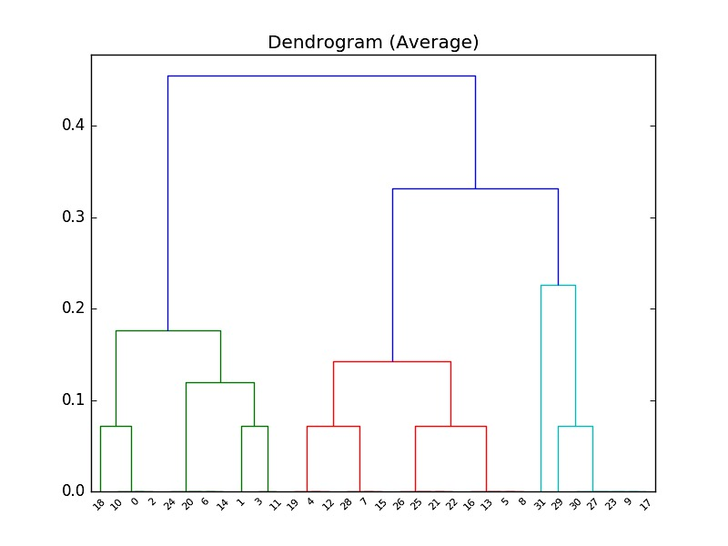

NCSA SPIN FELLOW
An Extensible Possible Worlds Explorer for Answer Set Programming
Project Objectives
Technical Approach
Status
To analyze the solutions (Possible Worlds) produced by Answer Set Programming (ASP) reasoners such as Clingo and DLV.
To develop ways to query, visualize, and interpret this data using relational databases such as SQLite Databases and Panda DataFrames.
To cluster similar and equivalent PWs to aid in finding fundamental solutions
To identify and analyze the ‘simplest’ solutions to an underspecified problem, based on a user-defined distance function between PWs. (Occam’s Razor: among competing explanations, the simplest one should be selected)
To conduct a case study, demonstrating the feasibility of the approach.
Parse the output of Cllingo ASP using the Antlr parsing tool.
Populate a relational database using the parsed data, with one table for each identified relation.
Implement functionality to execute powerful SQL and Python/Panda queries on these databases/dataframes.
Use these queries to discover interesting features about these Possible Worlds.
Clustering of PWs with user-defined distance metric (e.g., size of symmetric distance).
Analyze ’complexity’ of the various solutions.
Develop a stand-alone general tool that can be used by other tools like EulerX to then analyze more specific problems, using custom definitions of distance, complexity and visualization techniques.
Implemented Clingo Parser using Antlr which directly populates the parsed data into Panda DataFrames and SQLite Database.
Implemented queries such as intersection, union, frequency of specific tuples, instances of a relation in a solution, difference, symmetric difference, identify redundant attributes in relations, identify unique tuples , etc.
Implemented a general way of calculating dissimilarity/distance between two Possible Worlds using size of symmetric set difference as the distance metric.
Developed an interactive command-line UI to query these Possible Worlds.
Implemented a basic complexity analysis tool based on size of the solution.
Implemented clustering of the Possible Worlds based on a distance-matrix generated using the aforementioned distance metric.
Developed visualizations of these Possible Worlds such as Dendrograms and 2-D projection of these possible worlds.
Sahil Gupta
Rising Junior, Computer Science
Mentored by:
Prof. Bertram Ludäscher
Director, Center for Informatics Research in Science and Scholarship
Project Available at:
https://github.com/idaks/PW-explorer
Reference for Taxonomy Alignment Example:
Raunich, Salvatore, and Erhard Rahm. Target-driven merging of taxonomies with ATOM. Information Systems 42 (2014): 1-14.
Automobile Taxonomy Alignment Example:
Input:
Complexity Definition: Number of
overlap relations (><) in the PW:
select count(*) from rel_3
where x3 = “><“
and pw = pw_id
pw_id $∈$ [0,31]
Hierarchical Clustering (Dendrogram):
Clusters Identified:
PW-9
PW-17
PW-5
PW-8
PW-21
PW-26
PW-31
PW-23
PW-29
PW-16
PW-13
PW-25
PW-22
PW-27
PW-30
PW-15
PW-1
PW-3
PW-0
PW-2
PW- 7
PW-12
PW-20
PW-4
PW-6
PW-24
PW-19
PW-28
PW-11
PW-14
PW-10
PW-18
PWs: [31, 9, 17, 23, 27, 30, 29, 5, 8, 13, 16, 21, 22, 25, 26, 7, 15, 28, 4, 12, 19, 3, 11, 1, 6, 14, 20, 24, 18, 0, 2,10]
Complexities: [ 1.0, 0.79, 0.79, 0.79, 0.79, 0.79, 0.71, 0.57, 0.57, 0.57, 0.57, 0.5, 0.5, 0.5, 0.5, 0.43, 0.43, 0.43, 0.36, 0.36, 0.36, 0.29, 0.29, 0.21, 0.14, 0.14, 0.14, 0.14, 0.07, 0, 0, 0]
Decreasing Level of Complexity based on number of overlaps

